Slide 1
D-separation in more details

Slide 2
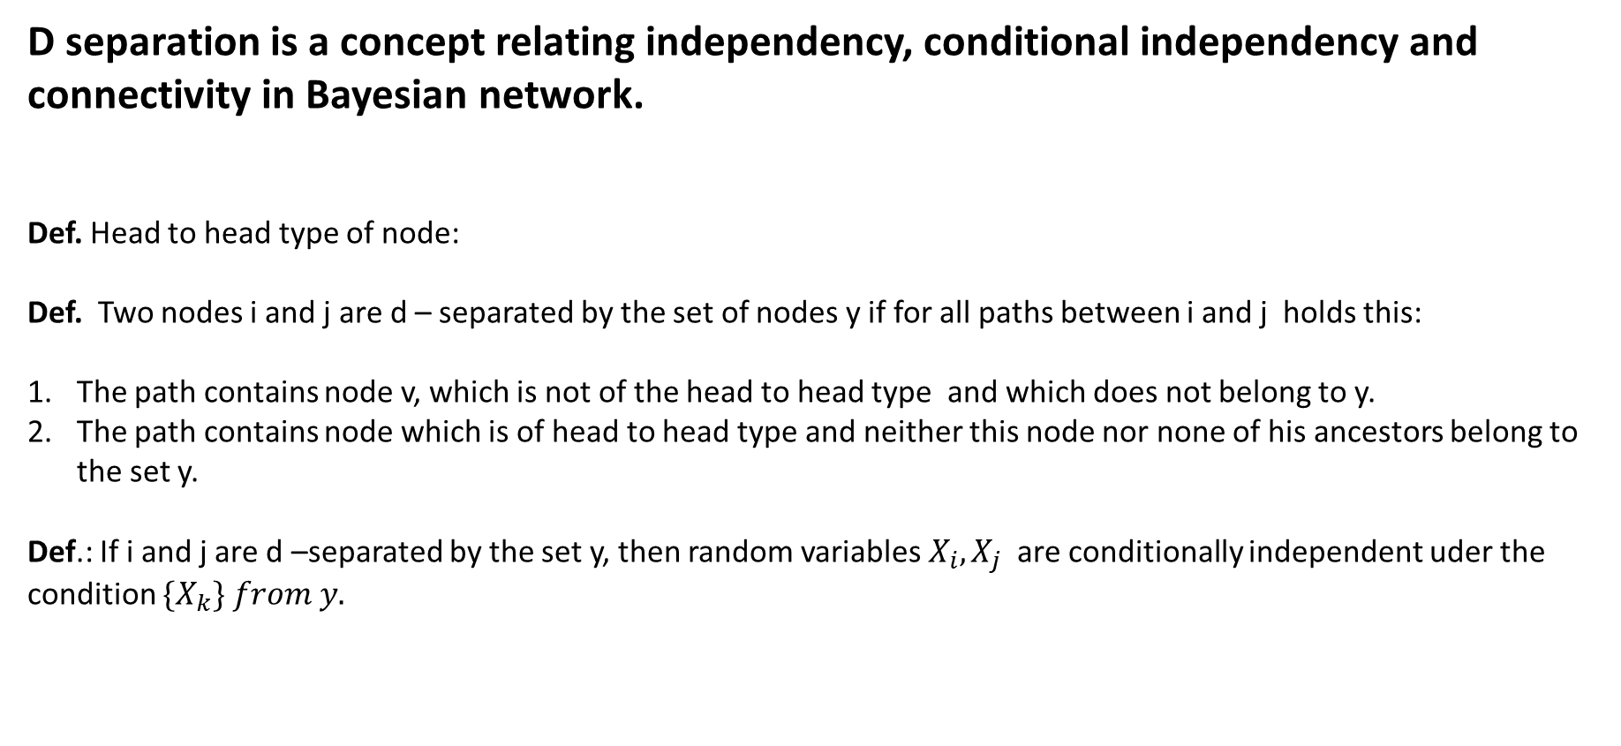
D separation is a concept relating independency, conditional independency and connectivity in Bayesian network.
Def. Head to head type of node:
Def. Two nodes i and j are d – separated by the set of nodes y if for all paths between i and j holds this:
The path contains node v, which is not of the head to head type and which does not belong to y.
The path contains node which is of head to head type and neither this node nor none of his ancestors belong to the set y.
Def.: If i and j are d –separated by the set y, then random variables $X_{i}, X_{j}$are conditionally independent uder the condition ${\{X}_{k}\} from y.$

Slide 3

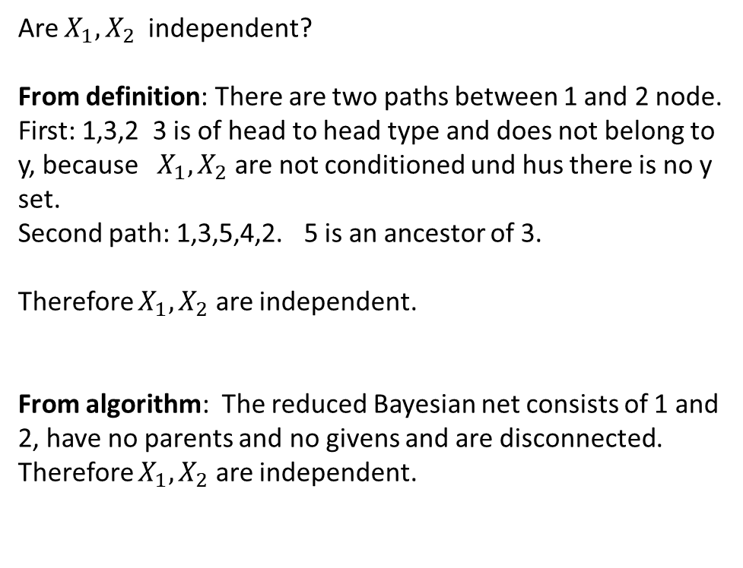




Example 1.
Are $X_{1}, X_{2}$independent?
From definition: There are two paths between 1 and 2 node.
First: 1,3,2 3 is of head to head type and does not belong to y, because $X_{1}, X_{2}$ are not conditioned und hus there is no y set.
Second path: 1,3,5,4,2. 5 is an ancestor of 3.
Therefore $X_{1}, X_{2}$ are independent.
From algorithm: The reduced Bayesian net consists of 1 and 2, have no parents and no givens and are disconnected. Therefore $X_{1}, X_{2}$ are independent.
$$X_{1}$$
$$X_{2}$$
$$X_{3}$$
$$X_{4}$$
$$X_{5}$$

Slide 4
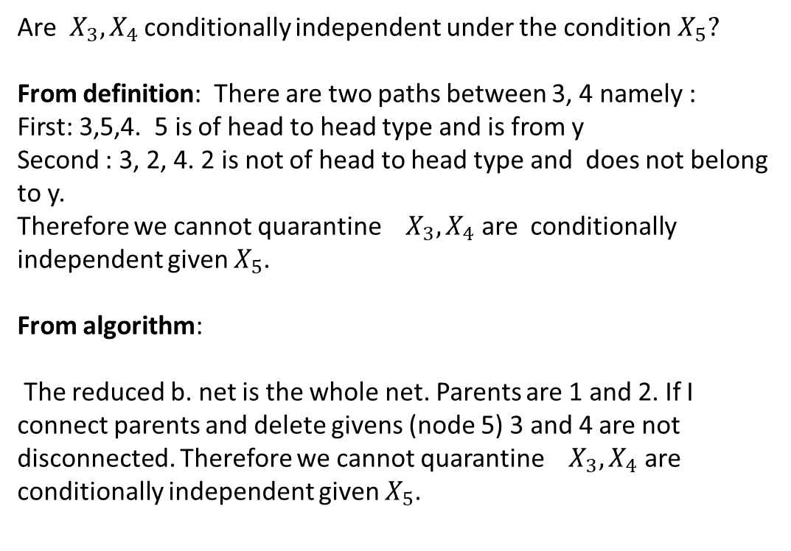
Example 2.
Are${ X}_{3}, X_{4}$ conditionally independent under the condition$X_{5}?$
From definition: There are two paths between 3, 4 namely :
First: 3,5,4. 5 is of head to head type and is from y
Second : 3, 2, 4. 2 is not of head to head type and does not belong to y.
Therefore we cannot quarantine ${ X}_{3}, X_{4}$ are conditionally independent given $X_{5}$.
From algorithm:
The reduced b. net is the whole net. Parents are 1 and 2. If I connect parents and delete givens (node 5) 3 and 4 are not disconnected. Therefore we cannot quarantine ${ X}_{3}, X_{4}$ are conditionally independent given $X_{5}$.
$$X_{1}$$
$$X_{2}$$
$$X_{3}$$
$$X_{4}$$
$$X_{5}$$

Slide 5
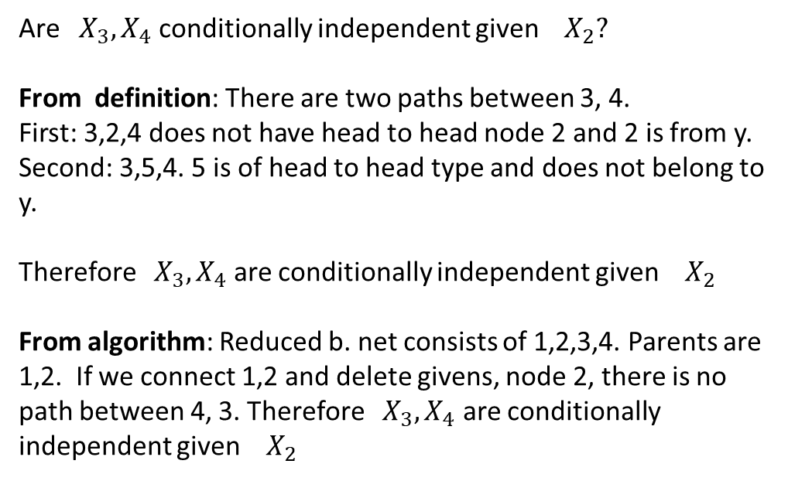
Example 3
Are ${ X}_{3}, X_{4}$ conditionally independent given ${ X}_{2}?$
From definition: There are two paths between 3, 4.
First: 3,2,4 does not have head to head node 2 and 2 is from y.
Second: 3,5,4. 5 is of head to head type and does not belong to y.
Therefore ${ X}_{3}, X_{4}$ are conditionally independent given ${ X}_{2}$
From algorithm: Reduced b. net consists of 1,2,3,4. Parents are 1,2. If we connect 1,2 and delete givens, node 2, there is no path between 4, 3. Therefore ${ X}_{3}, X_{4}$ are conditionally independent given ${ X}_{2}$
$$X_{1}$$
$$X_{2}$$
$$X_{3}$$
$$X_{4}$$
$$X_{5}$$
From these examples we see, that independency and conditional independency is treated the same way. Independency is in fact conditional independency with no condition.

